Slide 1
PERFORMANCE BASED CLUSTERING AND PREDICTION OF OPTIMAL PLAYING XI IN CRICKET Domain: Sports Analytics
Name: Akash K

Slide 2
Abstract
In this era, the most important term and person in the game of cricket is data and a data analyst. Analyzing and categorizing player performance across formats is essential for team selection and also player development. We aim to cluster various cricket players based on their statistics using machine learning techniques, providing a data-driven approach towards player classification. We follow data pre-processing steps like data cleaning, handling missing values and feature selection to capture meaningful performance indicators. We implement various data visualization charts to illustrate the data visually and get a better understanding of the data. We employ clustering algorithms like K-means and hierarchical clustering to group cricketers. Random Forest algorithm is used to find and predict the rank of a cricketer, which helps in team selection. Our Work aims to improve the team selection process. Our work would also benefit franchises who aim to buy the best players in the auction.

Slide 3
Introduction
In the dynamic world of cricket, analyzing player performance is crucial for strategic decision-making, both on and off the field. This project focuses on leveraging clustering techniques to group cricketers based on their performance statistics, such as highest scores (HS), runs scored, batting average, strike rate, centuries, half-centuries, and ducks, wickets, catches, economy. By utilizing these features, we aim to identify distinct player profiles that could represent various category of players.
We also aim to rank players based on the suitable metrics.
This analysis not only provides insights into player roles but also assists in talent scouting, team composition, and match strategy planning. The project employs advanced clustering algorithms to uncover hidden patterns in player performance, enabling data-driven insights in cricket analytics.

Slide 4
Need of study
This project addresses the need to classify and group cricketers based on their performance metrics, such as runs, strike rates, batting averages, and centuries, wickets, catches. By applying clustering techniques, this work aims to:
Simplify Player Profiling
Improve Analytical Insights
We aim to improve selection of players using the clustering approach by grouping the players based on their performance.
It would be beneficial for players and also franchises which would want to buy the best players.
Our work would also be beneficial for fantasy cricket users.

Slide 5
Problem Statement
Given a dataset about the statistics of cricket players, Our project aims to analyse the performance of players using Machine Learning techniques and use it for optimal team selection.

Slide 6
Objectives
To Group the cricketers based on their statistics using clustering techniques.
To perform player consistency analysis using the clustered data.
To develop a player ranking system using Random Forest Algorithm.
To Provide an optimal team selection using the obtained ranks.

Slide 7
Related Work
Raajesh, S., Martin, N., Jiji, J., Nair, A., & Haritha, H. (2024, May). Cricket Team Selection and Player Analysis using Data Analytics. In 2024 IEEE Recent Advances in Intelligent Computational Systems (RAICS) (pp. 1-6). IEEE. https://ieeexplore.ieee.org/abstract/document/10689923/
Methodologies used :K-Means Clustering
Outcome:Clustering allowed for more strategic approach to team selection

Slide 8
Paper 2
Vestly, D. J., Hariharan, S., Kukreja, V., Prasad, A. B., Swaraj, K., & Gopichand, D. (2023, May). Parametric Analysis of a Cricketer’s Performance using Machine Learning Approach. In 2023 7th International Conference on Intelligent Computing and Control Systems (ICICCS) (pp. 344-348). IEEE.
Methodologies used: SVM, Decision Tree, Random Forest, K-Means Clustering.
Outcome:93.64%, 91.87%, 95.78%

Slide 9
Paper 3
Priya, S., Gupta, A. K., Dwivedi, A., & Prabhakar, A. (2022, April). Analysis and winning prediction in T20 cricket using machine learning. In 2022 Second International Conference on Advances in Electrical, Computing, Communication and Sustainable Technologies (ICAECT) (pp. 1-4). IEEE.. https://ieeexplore.ieee.org/abstract/document/9807929/
Methodologies: Random Forest, Decision Tree, SVM
Outcome:74% accuracy, 73% accuracy, 68% accuracy

Slide 10
Paper 4
Tahir, M. A., Nazeer, M. T., Atta, H., Saeed, M. A., & Munir, A. (2022). Artificial Intelligence and Data Analytics in Cricket. Webology, 19(2). https://search.ebscohost.com/login.aspx?direct=true&profile=ehost&scope=site&authtype=crawler&jrnl=1735188X&AN=172018233&h=wozQ5PH4%2FkM8EZlcZw0Uv5%2BwFxbTjMb66rutD%2BO9SmloQug9cITg48pcUkTCzl3Y6KDaHCJlwGubbD%2Bic7H9eQ%3D%3D&crl=c
Methodologies: Naïve Bayes, Linear Regression
Outcome:68%-91% as match progressed, Less prone to errors

Slide 11
Paper 5
Dalal, P., Shah, H., Kanjariya, T., Joshi, D., Student of Computer Engineering, MukeshPatel School of Technology Management and Engineering Shirpur, SVKM’s NMIMS India, & Prof. of Computer Engineering, MukeshPatel School of Technology Management and Engineering Shirpur, SVKM’s NMIMS India. (2024). Cricket Match Analytics and Prediction using Machine Learning. International Journal of Computer Applications, 27–28. https://ijcaonline.org/archives/volume186/number26/dalal-2024-ijca-923744.pdf
Methodologies:Random Forest, SVM, Logistic Regression, Naïve Bayes
Outcome:89.82% accuracy,77.77% accuracy,77.28% accuracy,62.41% accuracy.

Slide 12
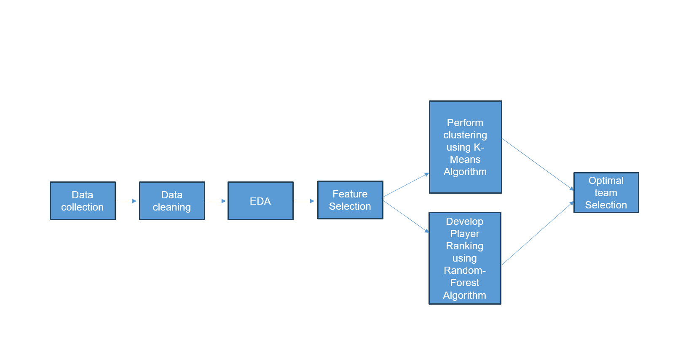
Proposed Methodology

Slide 13
Dataset
Cricket data: https://www.kaggle.com/datasets/mahendran1/icc-cricket
No. of Files: 9
No. of Observations: 2000-2700
No. of columns:11-15

Slide 14
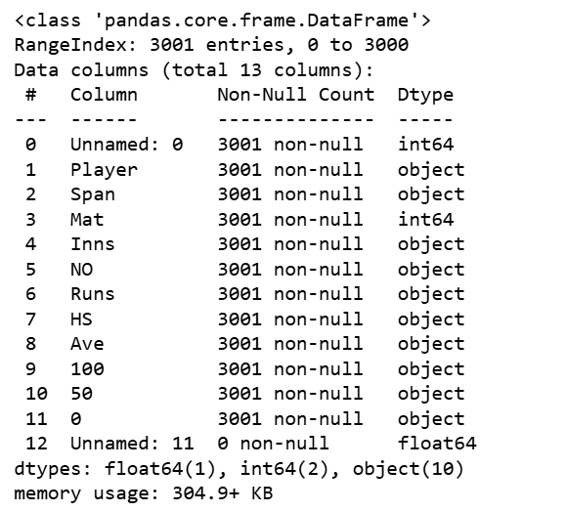
Dataset information-Batting

Slide 15
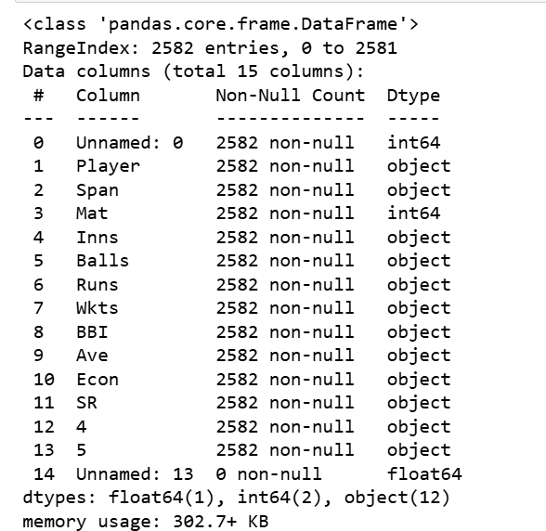
Dataset Information-Bowling

Slide 16
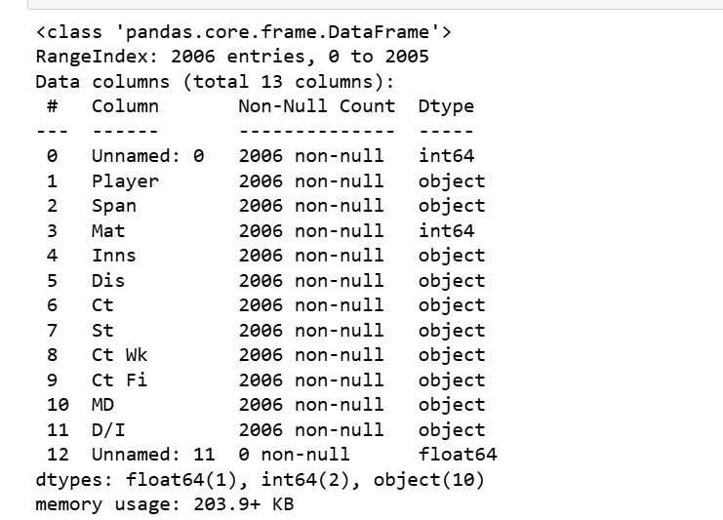
Dataset Information-Fielding

Slide 17
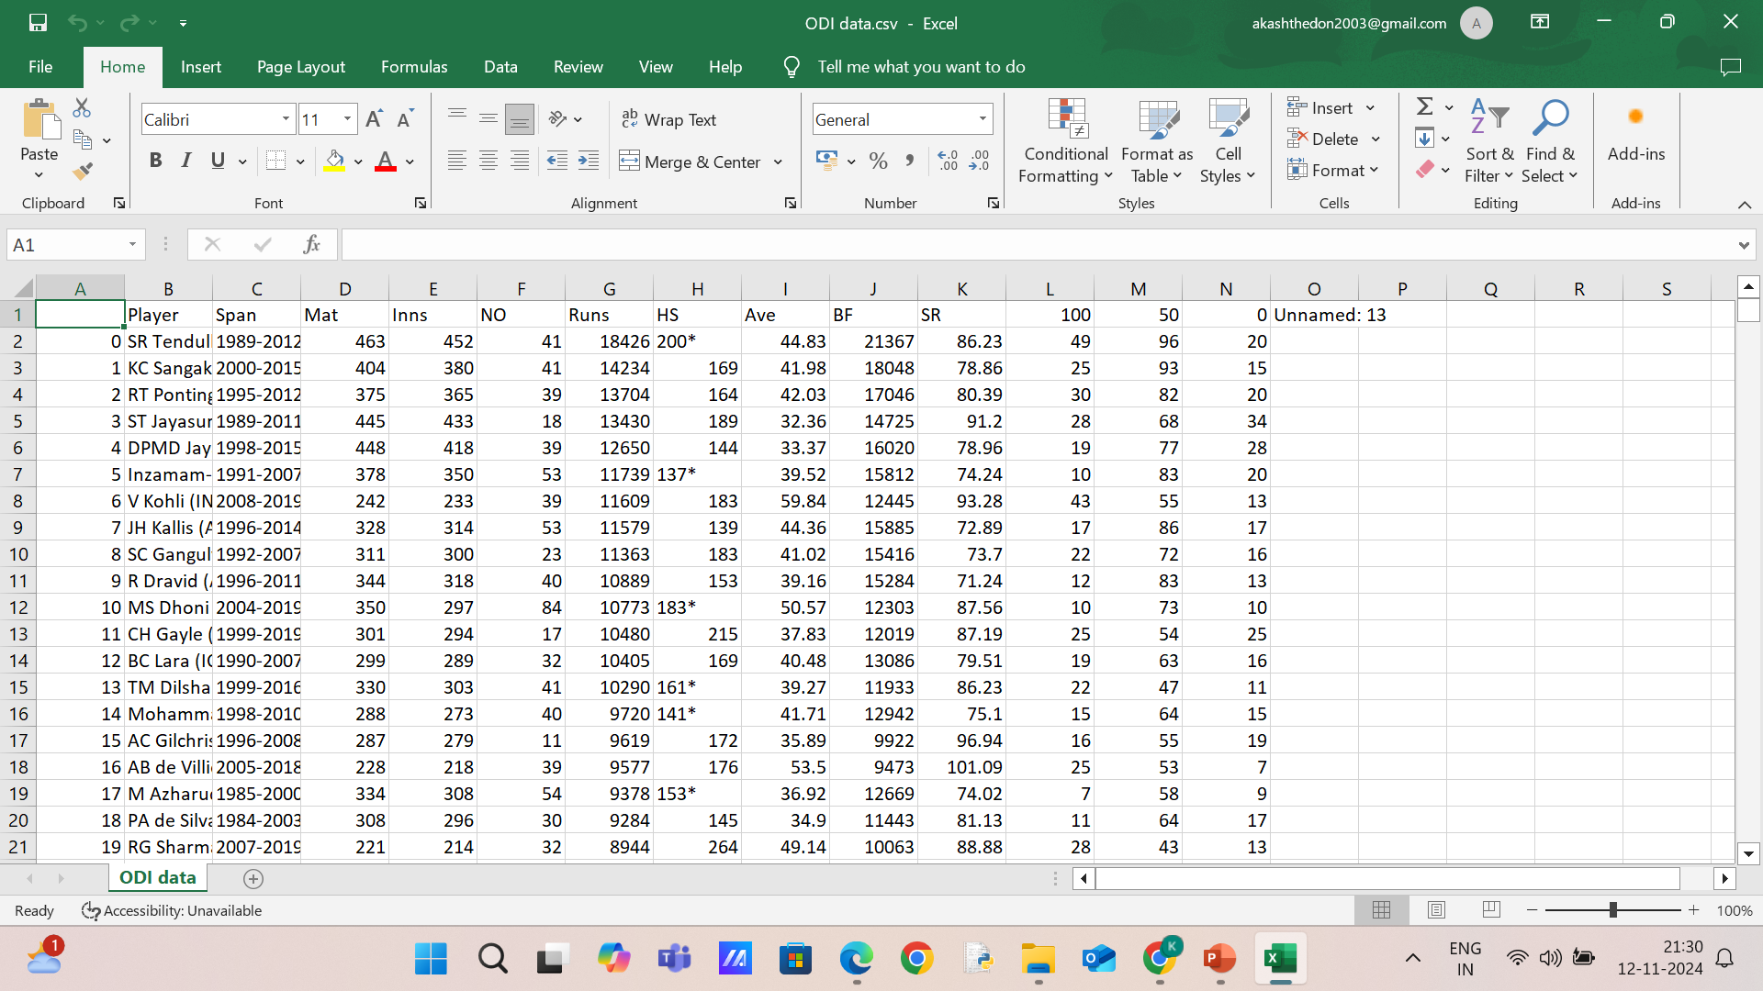
Screenshot-Batting

Slide 18
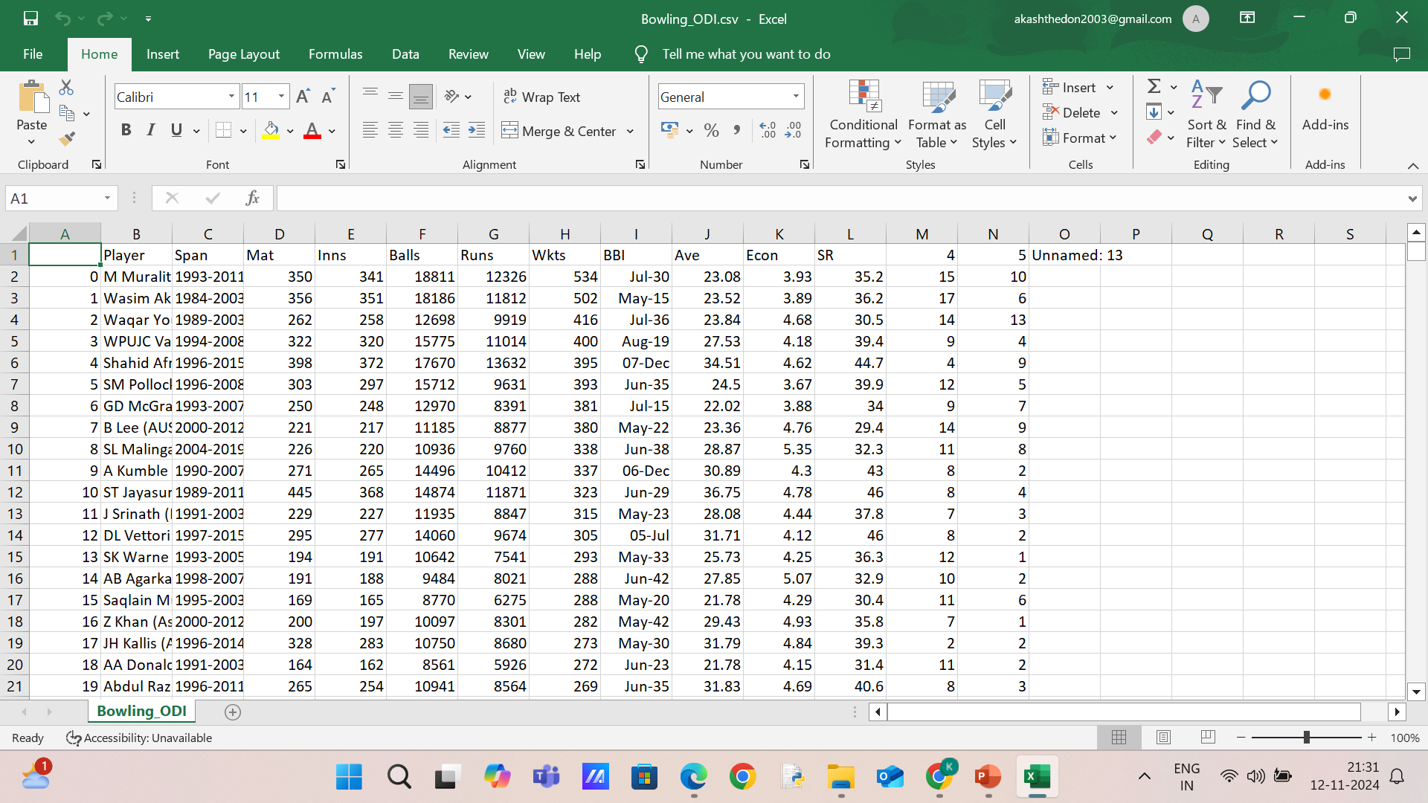
Screenshot-Bowling

Slide 19
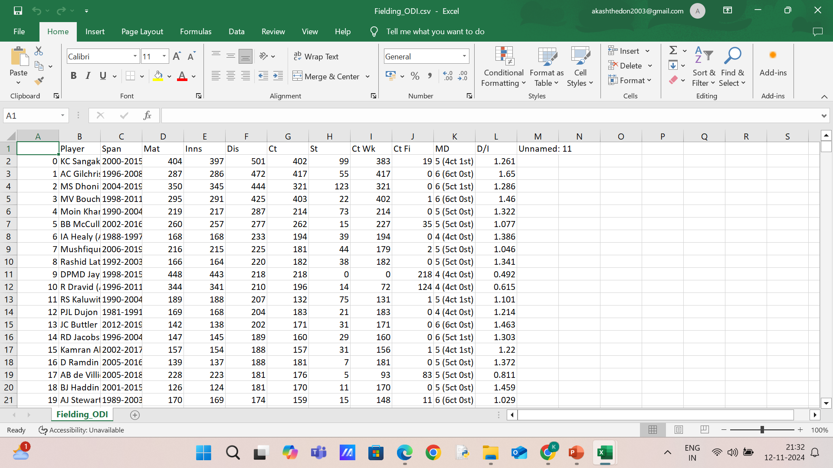
Screenshot-Fielding

Slide 20
Data Cleaning and Pre-Processing
Data Cleaning and Preprocessing:All the numeric columns were converted into float datatype, the data was replaced by 0 were ‘-’ were present.
Year span column was separated as start year and end year.
Player name and country were separated as two columns.
Not-out high scores of cricketers were handles.

Slide 21
Exploratory Data analysis
Visual analysis was performed in 2 ways: Format wise Visual analysis and Player Wise Visual Analysis.
Format wise visual analysis focused on the variance and similarities of the data in the three different formats namely Test, ODI and T20.
Player wise visual analysis aimed to visually show the statistics of a specific player.

Slide 22
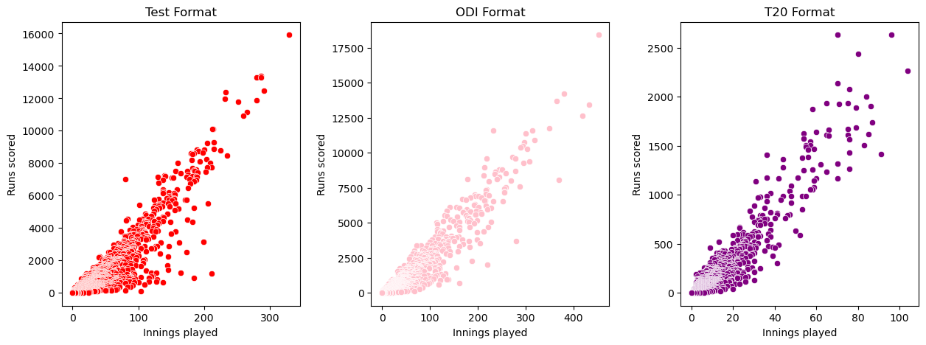
Format- Wise Analysis
What is the relationship between no. of innings and runs scored in each formats?
It can b interpreted from the scatterplot that innings played and runs scored have an increasing relationship.
As the no. of innings increases, the runs scored also increases.

Slide 23
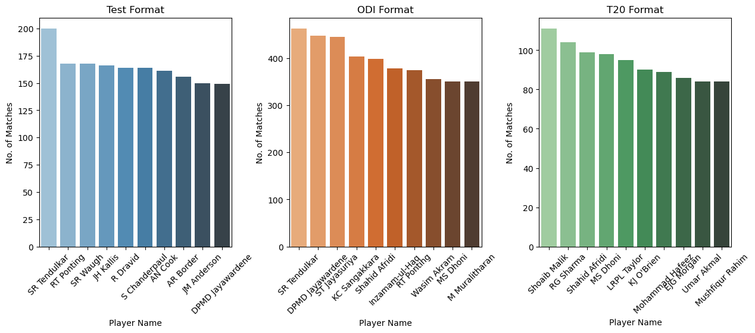
Who are the top 10 players who played most matches in each format?
The bar graph displays the top 10 players with most matches played.

Slide 24
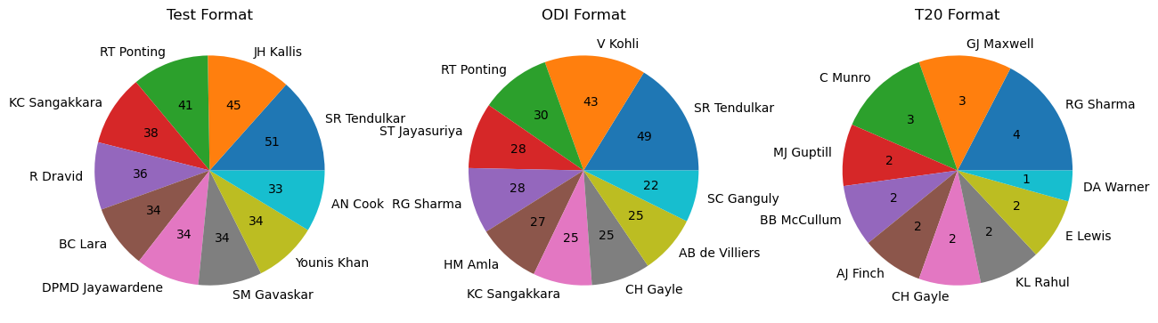
Who has hit the most centuries in each format?
The pie chart displays who hit the most centuries in each format

Slide 25
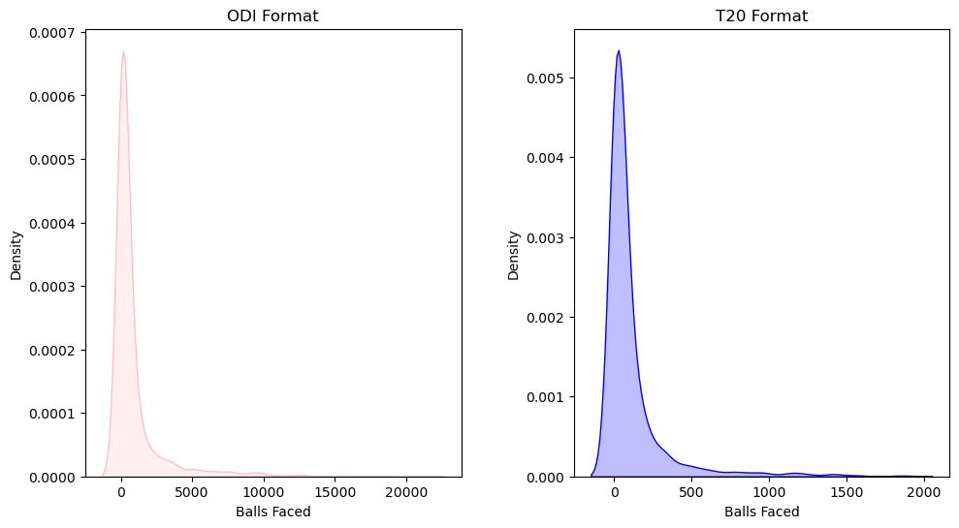
What is the density of balls faced by a batsmen in ODI and T20 formats?
It can be interpreted that the density of balls faced is higher in ODI than in T20.

Slide 26
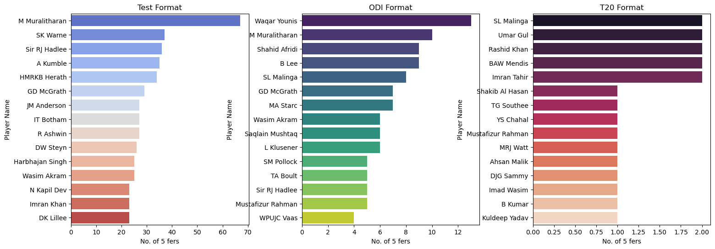
Who has most 5 wicket hauls in each format?
The bar graph displays the top 15 players with most 5 Wicket hauls

Slide 27
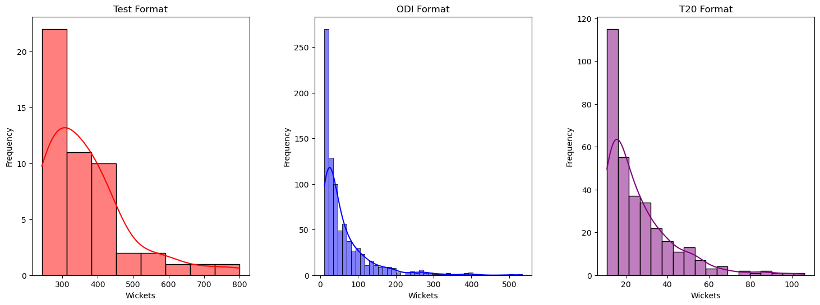
What is the distribution of wickets taken in each format?
Test matches offer bowlers more opportunities to take wickets, resulting in a broader range of wicket counts. In contrast, the shorter durations of ODIs and T20s limit bowlers from achieving such high totals.

Slide 28
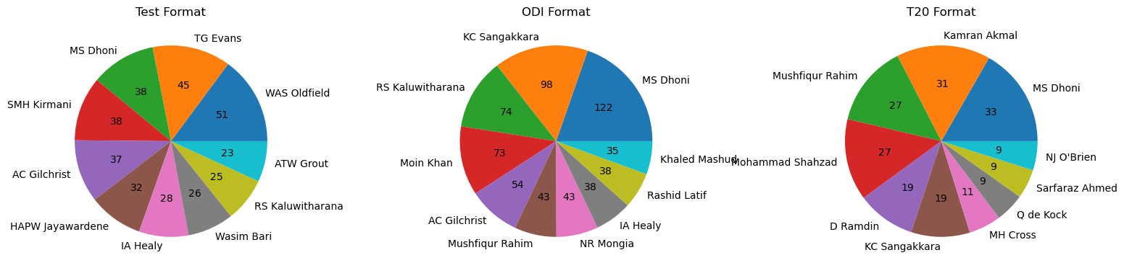
Who has the most stumpings in each format?
The pie chart displays the top 10 keepers with most stumpings.

Slide 29
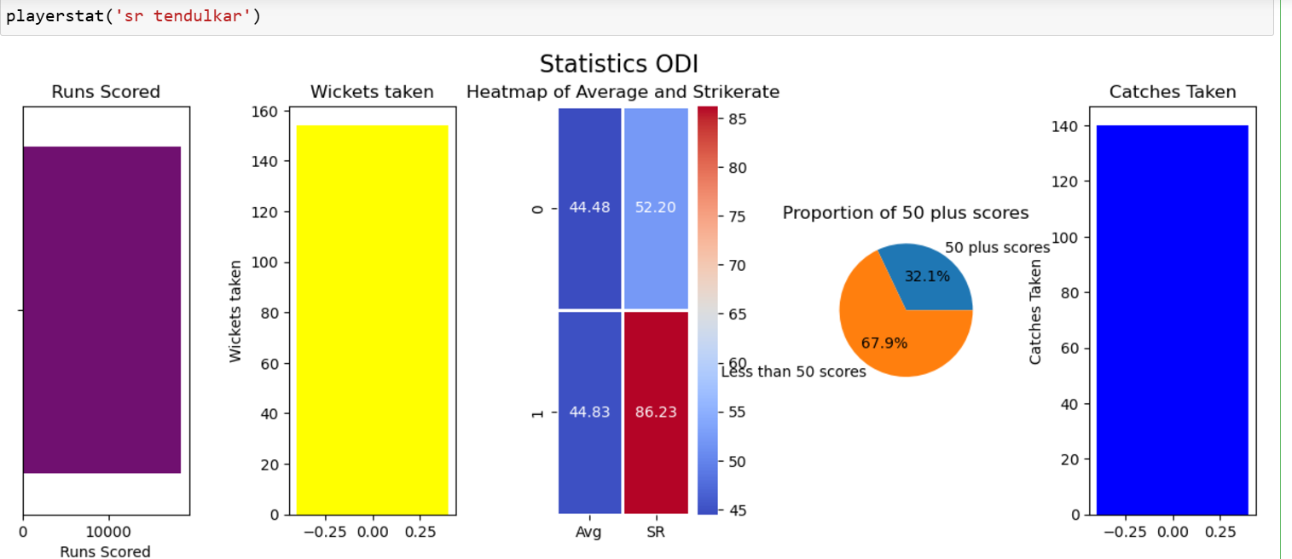
Player Wise Analysis

Slide 30
Interpretation
The function displays the basic and most important statistics of a specific player.
The stats which are displayed are runs scored, wickets taken, catches caught, percentage of 50 plus scores, bowling SR and Avg and Batting SR and Avg .

Slide 31
Player Consistency Analysis
Clustering Technique was used to perform consistency analysis of the cricketers data.
K-Means Clustering Algorithm was chosen to perform the clustering.
Each dataset was divided to form 3 clusters, indicating Good, Average and Bad performers.
Silhouette Score was used to evaluate the clusters efficiency.

Slide 32
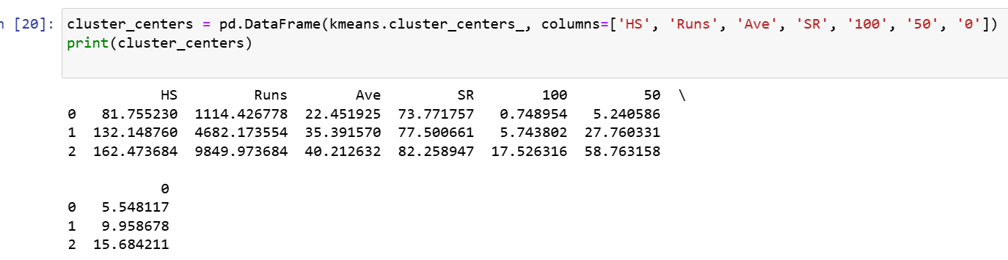
Clustering Of ODI Batting
Cluster 2-Good
Cluster 1-Average
Cluster 0-Bad
Silhouette Score for the clusters: 0.65

Slide 33
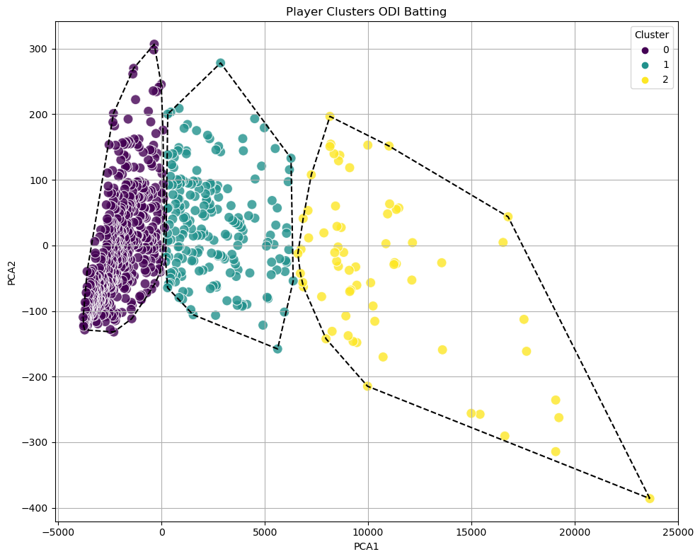
Clustering Of ODI Batting

Slide 34
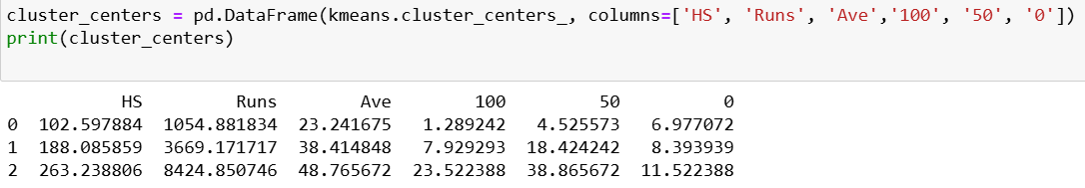
Clustering of Test Batting
Cluster 2 : Good
Cluster 1 : Average
Cluster 0 : Bad
Silhouette Score for the clusters : 0.65

Slide 35
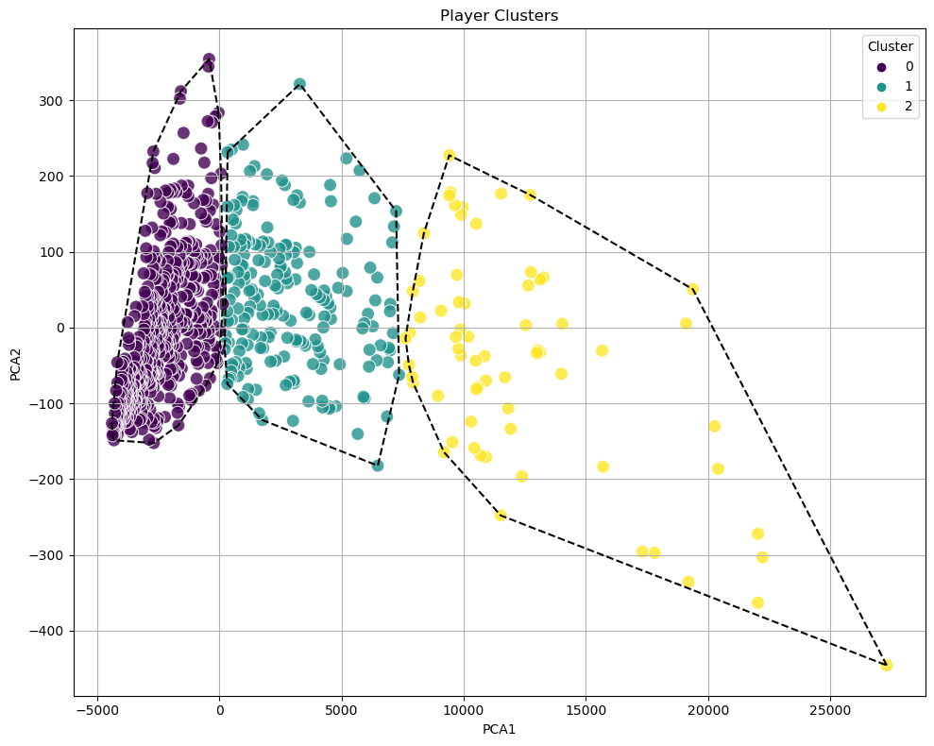
Clustering of Test Batting

Slide 36
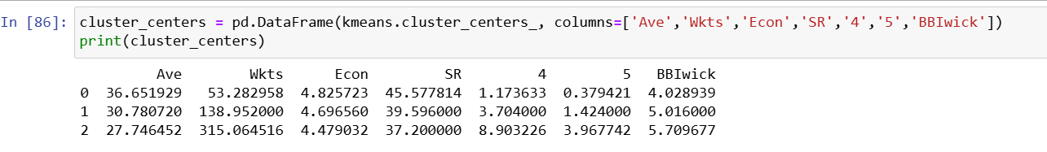
Clustering of ODI Bowling
Cluster 2 : Good
Cluster 1 : Average
Cluster 0 : Bad
Silhouette Score for the clusters : 0.57

Slide 37
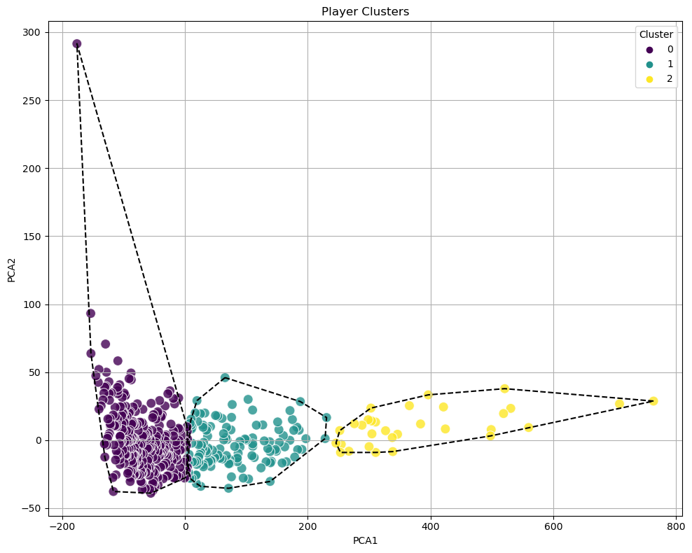
Clustering of ODI Bowling

Slide 38
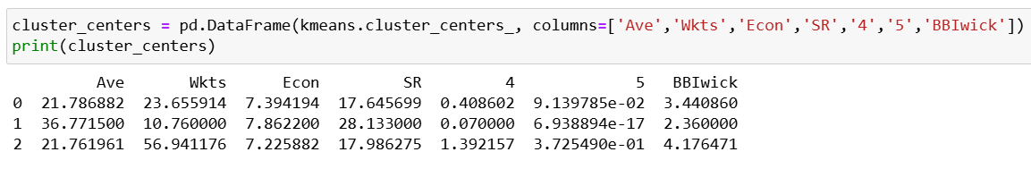
Cluster Centres
Cluster 2 : Good
Cluster 0 : Average
Cluster 1 : Bad
Silhouette Score for the clusters : 0.41

Slide 39
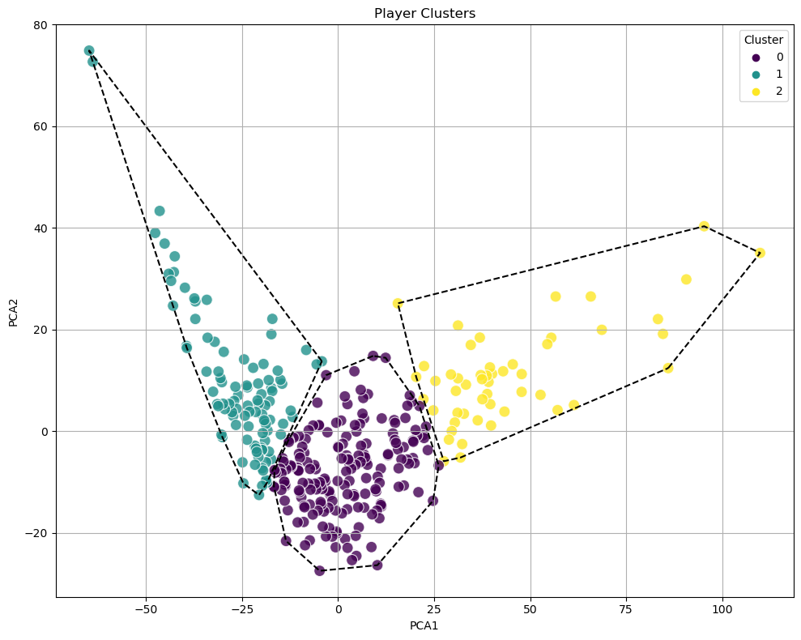
Clustering of T20 Bowling

Slide 40
Player Ranking and Optimal Team selection
A scoring system was developed for batting, bowling and fielding.
Metrics like Average, Strike rate, economy , wickets, runs, catches taken were considered.
The metrics were assigned weights based on their significance to the games.
The weighted sum of each department gave scores to each department.
Players were ranked in descending order based on their score.

Slide 41
Random Forest Model
Data Preparation: Player ranks as the target variable. Performance metrics as input features.
Model Training: Trained Random Forest on the performance data.
Output: Predicted Rank → Used for team selection.
The dataset was then sorted based on predicted rank to have top players at the top of the dataset.

Slide 42
Team Selection
Batsmen Selection: Filtered batting data based on country. Selected Top 7 Batsmen based on Predicted Rank.
Bowlers Selection: Filtered bowling data. Selected Top 7 Bowlers based on Predicted Rank.
Wicketkeeper Selection: Selected Top Wicketkeeper from fielding data based on Predicted Rank.

Slide 43
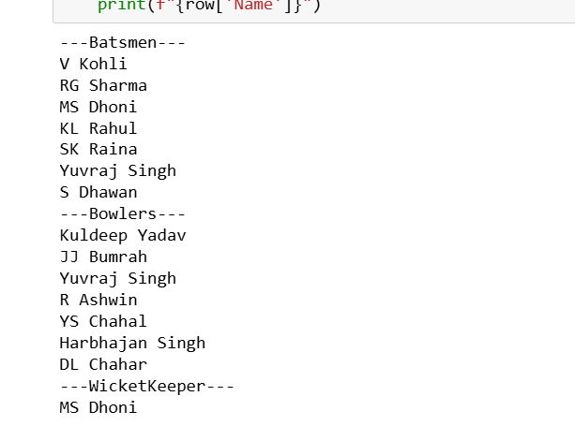
Optimal team for India

Slide 44
Performance Analysis
We have used Silhouette score to evaluate the clusters which are formed by the K-Means Clustering algorithm which measures how similar a data point is to its own cluster (cohesion) compared to other clusters (separation). The score ranges from -1 to 1.
Cluster | Silhouette Score
ODI Batting | 0.65
Test Batting | 0.65
ODI Bowling | 0.57
T20 Bowling | 0.41

Slide 45
Player Ranking Accuracy
The accuracy of the Random Forest model was evaluated using the accuracy score by comparing the predicted rankings to the actual or predefined player rankings which was calculated using the weighted score calculated.
Dataset | Accuracy
T20 Batting | 80%
T20 Bowling | 80%
T20 Fielding | 91%

Slide 46
Conclusion
The data was cleaned and Pre-processed in order for it to be suitable for clustering and for Exploratory data analysis.
Format wise visual analysis was performed where we were able to interpret how the data differs in each format.
Player wise visual analysis was performed where we were able to visualise the statistics of a specific player.
We applied K-means clustering algorithm to group the cricketers into 3 categories namely Good, Average, Bad.
Silhouette score was used as an evaluation metric for the clusters.
We implemented Random Forest to rank players based on performance metrics.
Optimal team was selected based on the Predicted ranks.

Slide 47
Future Enhancement
Incorporation of advanced data like performance in home grounds and away grounds, active players.
Developing Visualization Dashboards or an Application.
Advanced Methods for Assigning weights.

Slide 48
References
Vestly, D. J., Hariharan, S., Kukreja, V., Prasad, A. B., Swaraj, K., & Gopichand, D. (2023, May). Parametric Analysis of a Cricketer’s Performance using Machine Learning Approach. In 2023 7th International Conference on Intelligent Computing and Control Systems (ICICCS) (pp. 344-348). IEEE. https://ieeexplore.ieee.org/abstract/document/10142664/
Raajesh, S., Martin, N., Jiji, J., Nair, A., & Haritha, H. (2024, May). Cricket Team Selection and Player Analysis using Data Analytics. In 2024 IEEE Recent Advances in Intelligent Computational Systems (RAICS) (pp. 1-6). IEEE. https://ieeexplore.ieee.org/abstract/document/10689923/
Priya, S., Gupta, A. K., Dwivedi, A., & Prabhakar, A. (2022, April). Analysis and winning prediction in T20 cricket using machine learning. In 2022 Second International Conference on Advances in Electrical, Computing, Communication and Sustainable Technologies (ICAECT) (pp. 1-4). IEEE.. https://ieeexplore.ieee.org/abstract/document/9807929/
Tahir, M. A., Nazeer, M. T., Atta, H., Saeed, M. A., & Munir, A. (2022). Artificial Intelligence and Data Analytics in Cricket. Webology, 19(2). https://search.ebscohost.com/login.aspx?direct=true&profile=ehost&scope=site&authtype=crawler&jrnl=1735188X&AN=172018233&h=wozQ5PH4%2FkM8EZlcZw0Uv5%2BwFxbTjMb66rutD%2BO9SmloQug9cITg48pcUkTCzl3Y6KDaHCJlwGubbD%2Bic7H9eQ%3D%3D&crl=c
Dalal, P., Shah, H., Kanjariya, T., Joshi, D., Student of Computer Engineering, MukeshPatel School of Technology Management and Engineering Shirpur, SVKM’s NMIMS India, & Prof. of Computer Engineering, MukeshPatel School of Technology Management and Engineering Shirpur, SVKM’s NMIMS India. (2024). Cricket Match Analytics and Prediction using Machine Learning. International Journal of Computer Applications, 27–28. https://ijcaonline.org/archives/volume186/number26/dalal-2024-ijca-923744.pdf

